Slide 1
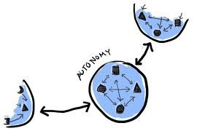
MOOC Online Support
Stephen Downes
September 10, 2012

Slide 2
Traditional Course
Traditional
Course
Website
Most online courses are based on websites (even Coursera, Klan and Udemy)

Slide 3
Massive Open Online Course
Site
A MOOC is a Web, not a Website

Slide 4
Underlying MOOC Support
1. First student creates resource and sends info to course
Site
2. Second student sees resource info in newsletter and RSS feed
3. Second student accesses the resource directly
4. Second student finds link to third student’s resource

Slide 5
The Student’s Perspective
Site
A range of different resources and services

Slide 6
Course Provider Perspective
Subscribed
students
Student
content
Site
Course
content
Live online events
Event recordings

Slide 7
gRSShopper Functionality
Harvester
- atom, RSS, JSON
- blogs, discussions, pages
- Twitter, Facebook, etc
User management
- Login and authentication
- Newsletter subscription
- Social network information
Feed Manager
Distribution
- Email newsletter
- RSS / Atom / JSON feeds
- API to Twitter, Facebook, etc
Site Manager
- Course pages
- Events, etc.
- Newsletter pages

Slide 8
Underlying Principles
Autonomy
- Choice of contents
- Personal learning
- No curriculum
Openness
- Open access
- Open content
- Open activities
- Open assessment
Diversity
- Multiple tools
- Individual perspective
- Varied content
Interactivity
- Encourage communication
- Cooperative learning
- Emergent knowledge

